Slide 1

RESTAURANT REVIEW ANALYSIS
Batch No -17
Guide-Ms Flora Ann Mathew
2111cs030016-K.Ashwin Kumar
2111cs030017-N.Bharath
2111cs030032-I.Gokul
2111cs030074-P.Pramod Reddy
2111cs030084-A.Raghava Krishna

Slide 2

Introduction
Restaurant review analysis involves systematically examining customer feedback and reviews from various platforms to gain insights into the restaurant's performance. This process helps restaurants understand customer satisfaction, identify areas for improvement, and enhance overall service quality.
IMPORTANCE
Customer Feedback: Provides direct insights from diners about their experiences.
Improvement Opportunities: Highlights specific areas where the restaurant can improve, such as food quality, service, or ambiance.
Decision Making: Informs data-driven decisions for menu development, marketing strategies, and operational enhancements.
Competitive Edge: Helps restaurants stay competitive by understanding market trends and customer preferences
​

Slide 3
WorkFlow
Data collection
Data processing
Dashboard creation
In this step we have collected the
Dataset from the Kaggle website i.e
Swiggy Restaurant reviews
.
In this step we have cleaned the dataset by removing unnecessary
Rows i.e the restaurant details of other cities other than Hyderabad
and the restaurant details where the rating values are null
After the data is cleaned the dadaset is loaded into Power bi
And we have created a dashboard design and inserted the required visuals into the dashboard that helps us in identifying the best restaurant and what kind of cuisine is preferred mostly by the customers

Slide 4
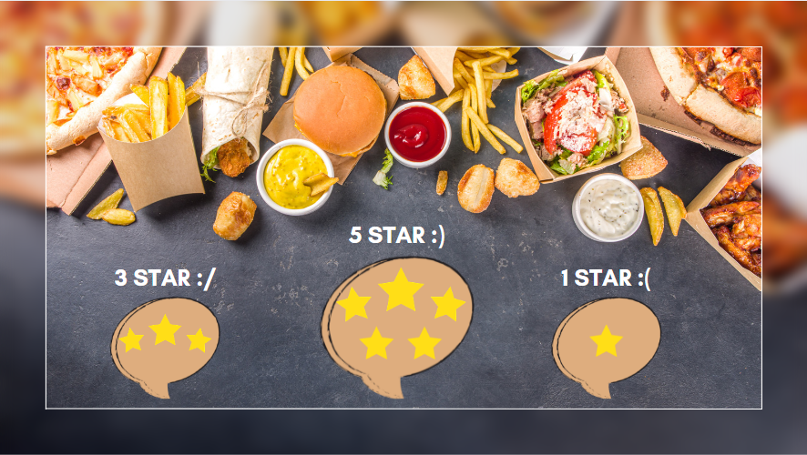
Benefits
Personalized Recommendations
Enhanced Dining Experience
Analysis of reviews can help platforms like Swiggy provide personalized recommendations based on user preferences and past reviews, enhancing the user experience.
As restaurants improve based on review feedback, customers benefit from higher-quality food and better service, leading to more satisfying dining experiences.
Quality Control
Review analysis helps the platform ensure that listed restaurants maintain high standards of quality and service, which is crucial for retaining customers and building brand reputation.

Slide 5
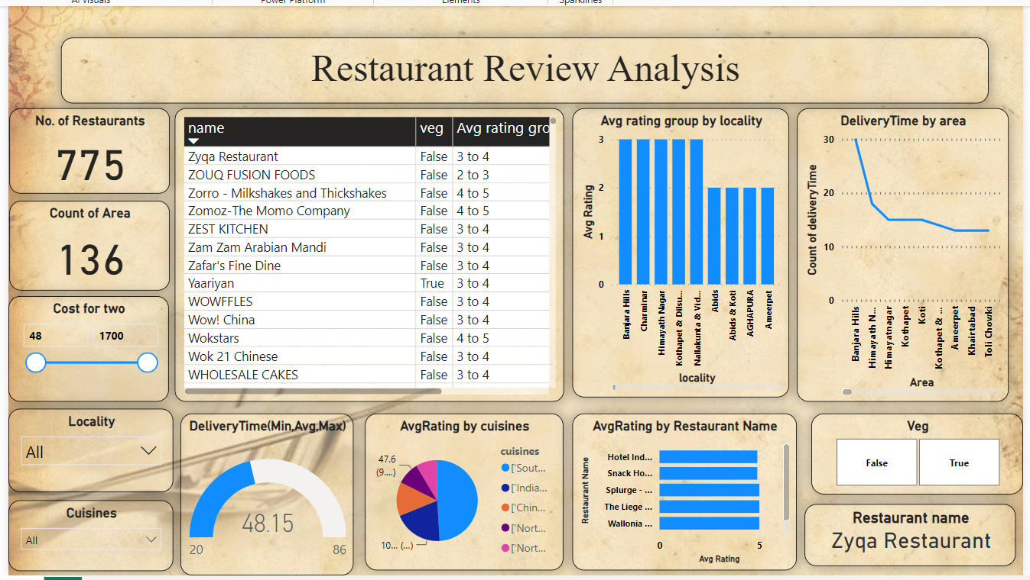
result

Slide 6


Future scope
Predictive analytics can forecast customer preferences and behavior patterns, allowing restaurants to tailor their offerings and improve customer satisfaction.
By understanding customer preferences through review analysis, restaurants can create highly targeted promotions and discounts
Analysis of reviews can reveal popular dishes and ingredients, guiding restaurants in menu development and innovation.

Slide 7

Thank You
Than

